Slide 1
Protecting Dev/Test Data by Design: Creating a Data Masking Strategy Chris Unwin, Compliant Database DevOps Specialist, Redgate Software

Slide 2
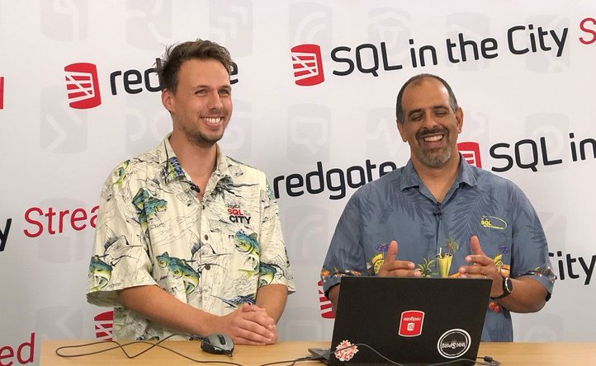


A little bit about me…
Chris Unwin
Data Privacy and Protection Specialist @ Redgate
Chris.Unwin@red-gate.com
DBAle on Spotify and iTunes
/in/christopherunwincambridge/
@RedG_Chris on Twitter

Slide 3
A little bit about Redgate…
300
20
202,000
Redgaters and counting
years old
customers
2m
91%
1147
SQL Server Central and Simple Talk users
Of the Fortune 100 use our tools
product releases last year

Slide 4

So is this a vendor session…?
Nope!

Slide 5

Quick Agenda
Why should we be masking data?
What does Data Masking do?
How do we start masking?

Slide 6
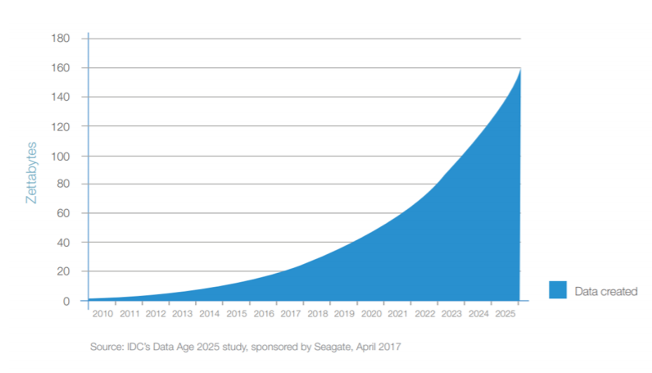
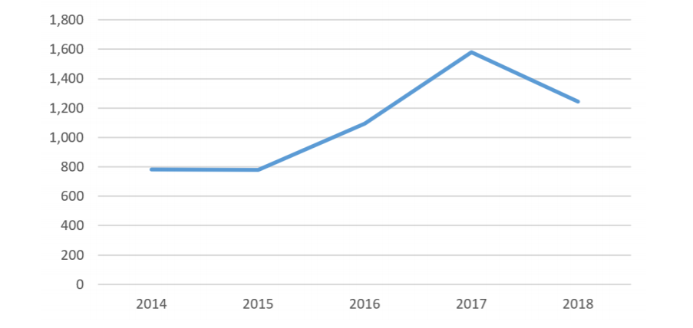
Why do we need to protect data?
Worldwide data handling
Worldwide data breaches

Slide 7
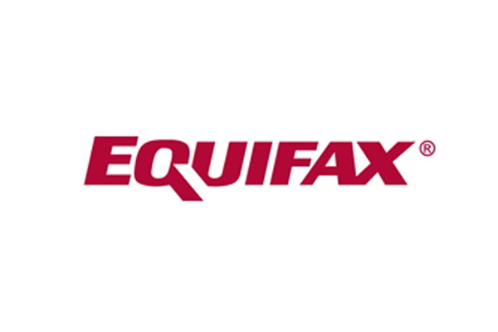

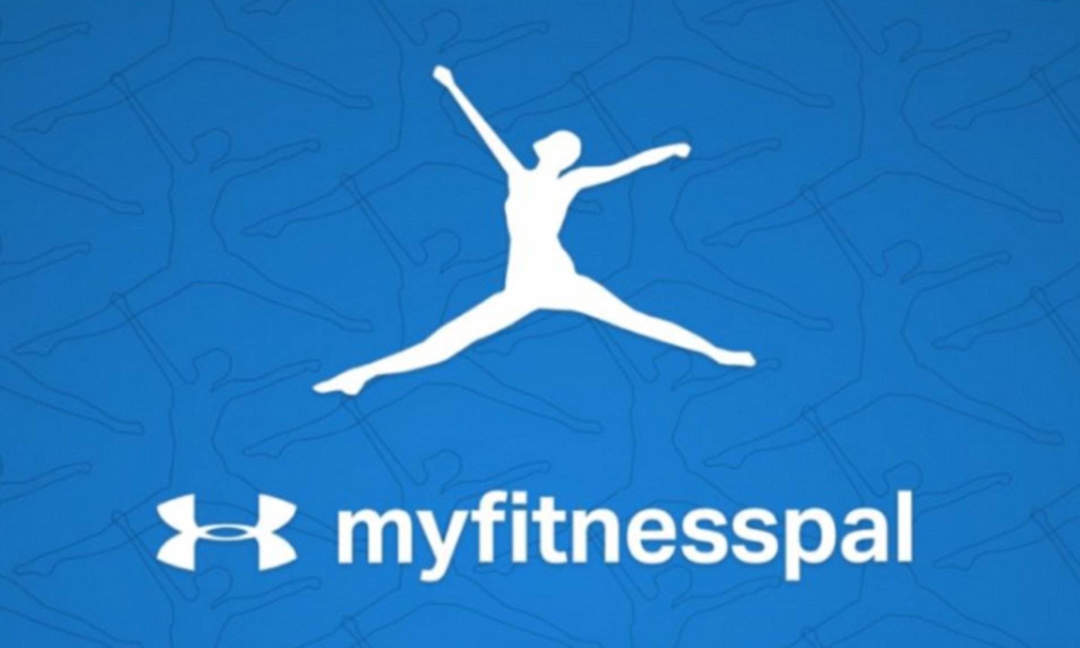


Why do we need to protect data? (2)

Slide 8
Why do we need to protect data? (3)
Increasing tide of laws & legislation
HIPAA, POPI, SOX, PCI, EU GDPR, CaCPA, NIST 800-53 revision 5…
Ongoing industry specific regulations & requirements
Securities & Exchanges Commission (SEC), Federal Trade Commission, Commodity Futures Trading Commission (CFTC), The Financial Conduct Authority, NHS Digital…
Marriott: $123m British Airways: $230m

Slide 9
There’s lots of ways to protect Data!
Keep the SQL Server patched & up to date
Control access
Limit numbers of Admins
Disable ‘sa’
Audit failed and successful logins regularly
Enable Encryption
Transparent Data Encryption (TDE)
Row Level Encryption
Always Encrypted
Data Masking

Slide 10
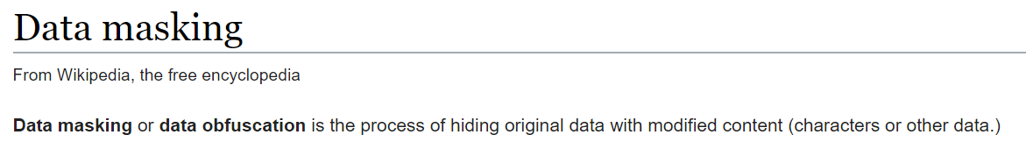
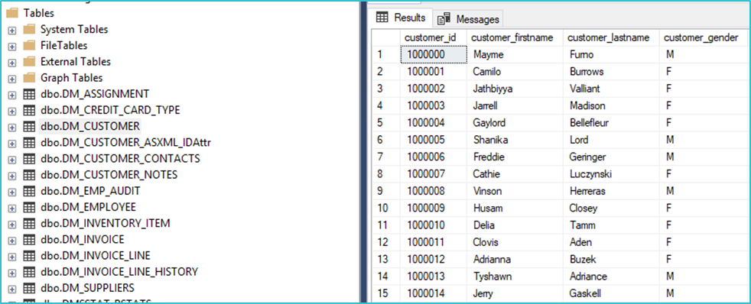
What is Data Masking?

Slide 11

We must set guardrails
Notes:
Chris is primary on this section
https://unsplash.com/photos/RzzERMs0McA

Slide 12
Minimize PII in datasets
Control available datasets
Personal Data shall be:
(b) collected for specified, explicit and legitimate purposes and not further processed in a manner that is incompatible with those purposes;
(e) kept in a form which permits identification of data subjects for no longer than is necessary for the purposes for which the personal data are processed;
Personal Data shall be:
(c) adequate, relevant and limited to what is necessary in relation to the purposes for which they are processed (‘data minimisation’);
(f) processed in a manner that ensures appropriate security of the personal data, including protection against unauthorised or unlawful processing and against accidental loss, destruction or damage, using appropriate technical or organisational measures (‘integrity and confidentiality’).

Slide 13
Control available datasets
We want to enable on-demand self service
We do NOT want
Copies of datasets everywhere
Insufficient storage
PII in datasets
Notes:
https://unsplash.com/photos/j6brni7fpvs

Slide 14

Static vs Dynamic Data Masking
Static:
XYZ
XYZ
Dynamic:
(in MSSQL 2016+)
ABC
XYZ
Masking

Slide 15

Why Static?
Data should be portable – all of the use and none of the risk
3rd party data usage
Off-Shore development
Analytics
Business Intelligence & Profiling
Devs & Testers don’t need real data

Slide 16
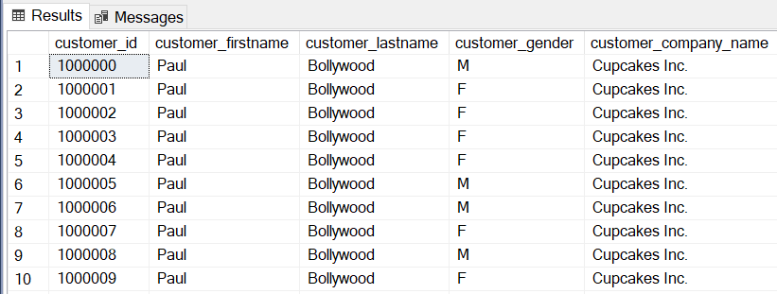
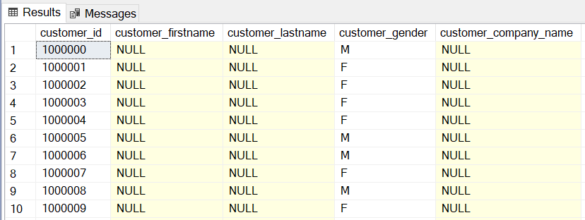
So technically…

Slide 17

We must think about some things first…

Slide 18
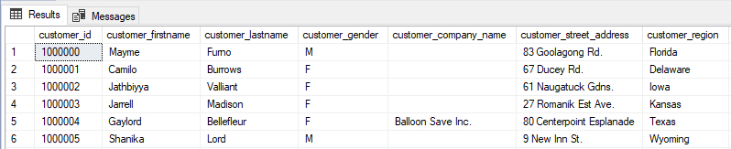
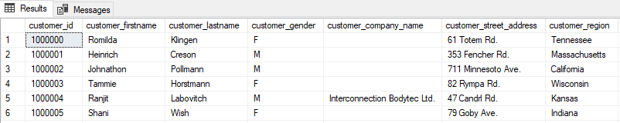
1. We require Realism
It has to look like our data to be realistic for dev & test
We want to use our own sets of data to retain realism
We want to retain the usefulness, demographic and storage profile
NULLs have a part to play
How do we deal with free-text? Remove it all? Use excerpts from a book?

Slide 19
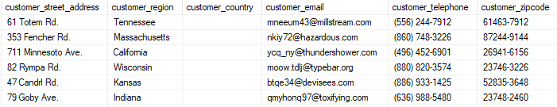
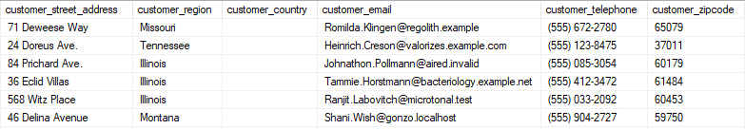
2. Data depends on Data
Not every column exists in isolation from others
Some columns are concatenations of, or are correlated with others
We want data to still validate in test copies of our application like addresses
We want useful email addresses, but don’t want to send anything to a living individual

Slide 20
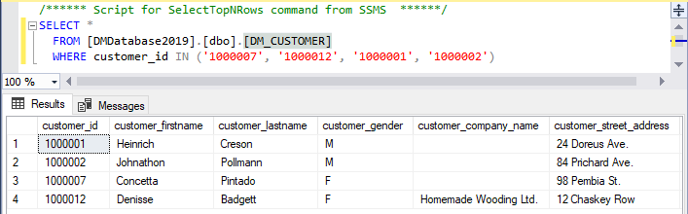
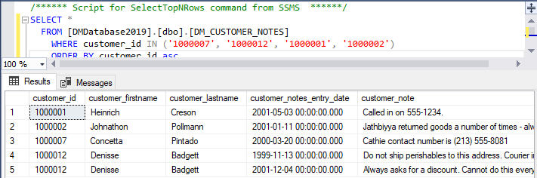
3. Perfect normalization is a dream
Denormalization happens
Data should be consistent across tables where there is duplication
We don’t want to have to set up fresh masks for every column on every table
Once we have masked core tables we should be able to persist this elsewhere

Slide 21
4. It needs to be fast!
There’s no point to any of this if it takes us 14 days to mask 10,000,000 rows!
We must optimize for speed – even if it means trading off resource power
We don’t want to slow down developers by waiting for masking to complete
It is a resource heavy operation and we would prefer everything ran concurrently where possible
Where is any of this happening anyway?
Notes:
https://unsplash.com/photos/Tof1HYnm0LY

Slide 22
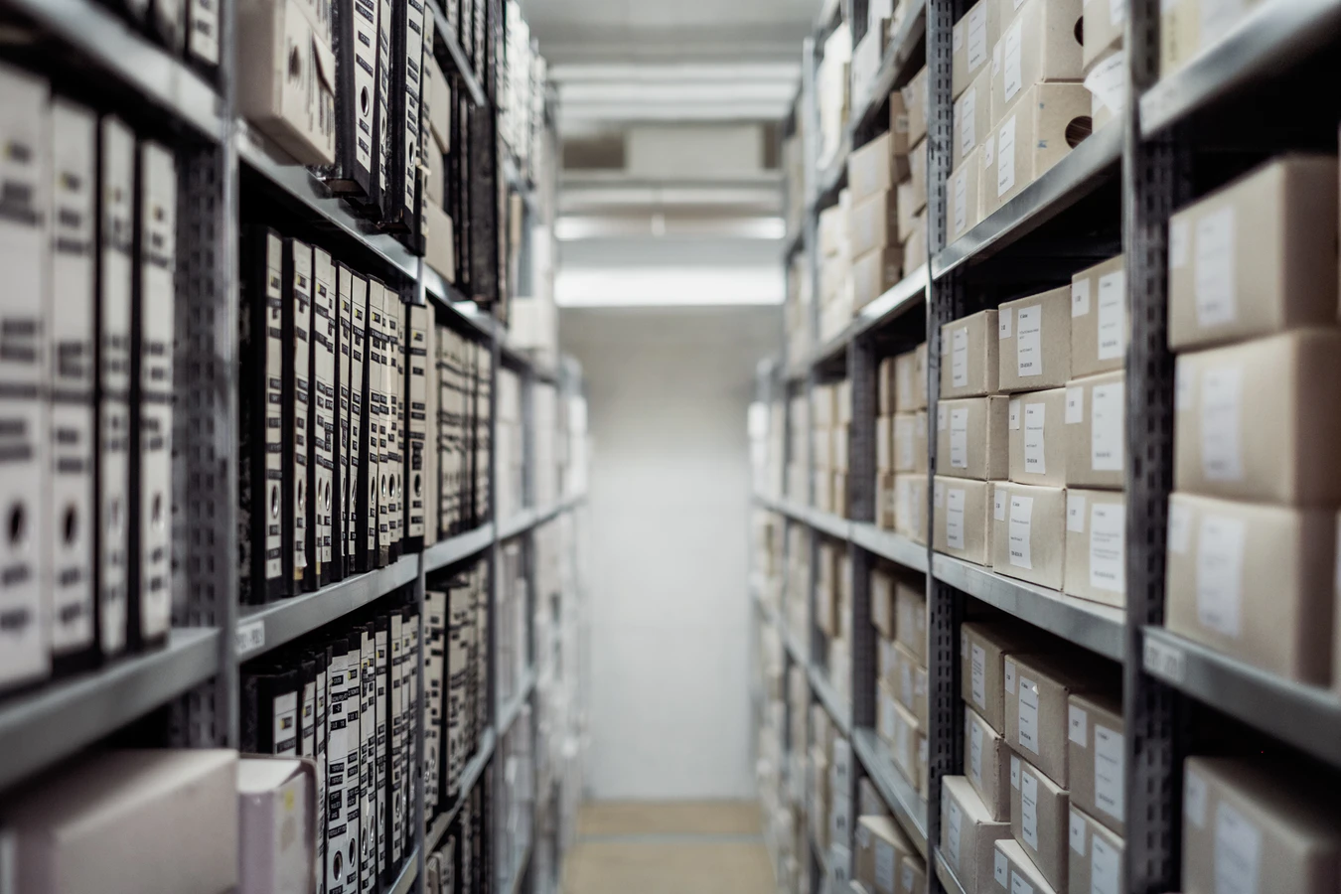
BUT… We can’t mask if we don’t know what we have!

Slide 23

Understand your data first
Identify where your data is
Identify what your data is
Identify where the risk lies

Slide 24
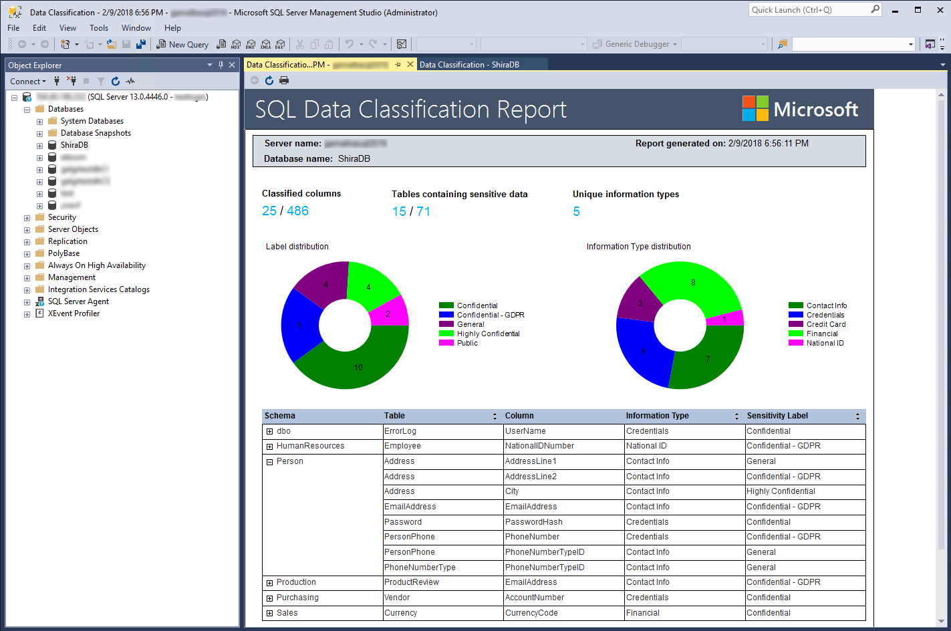
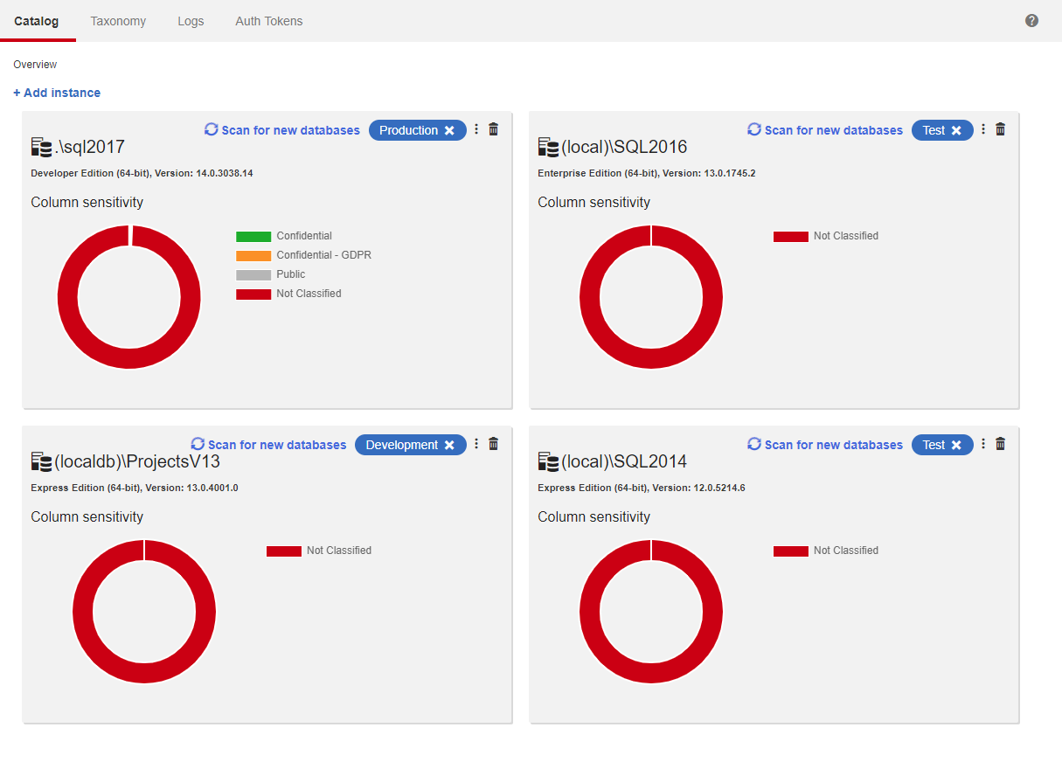
Catalog your data

Slide 25
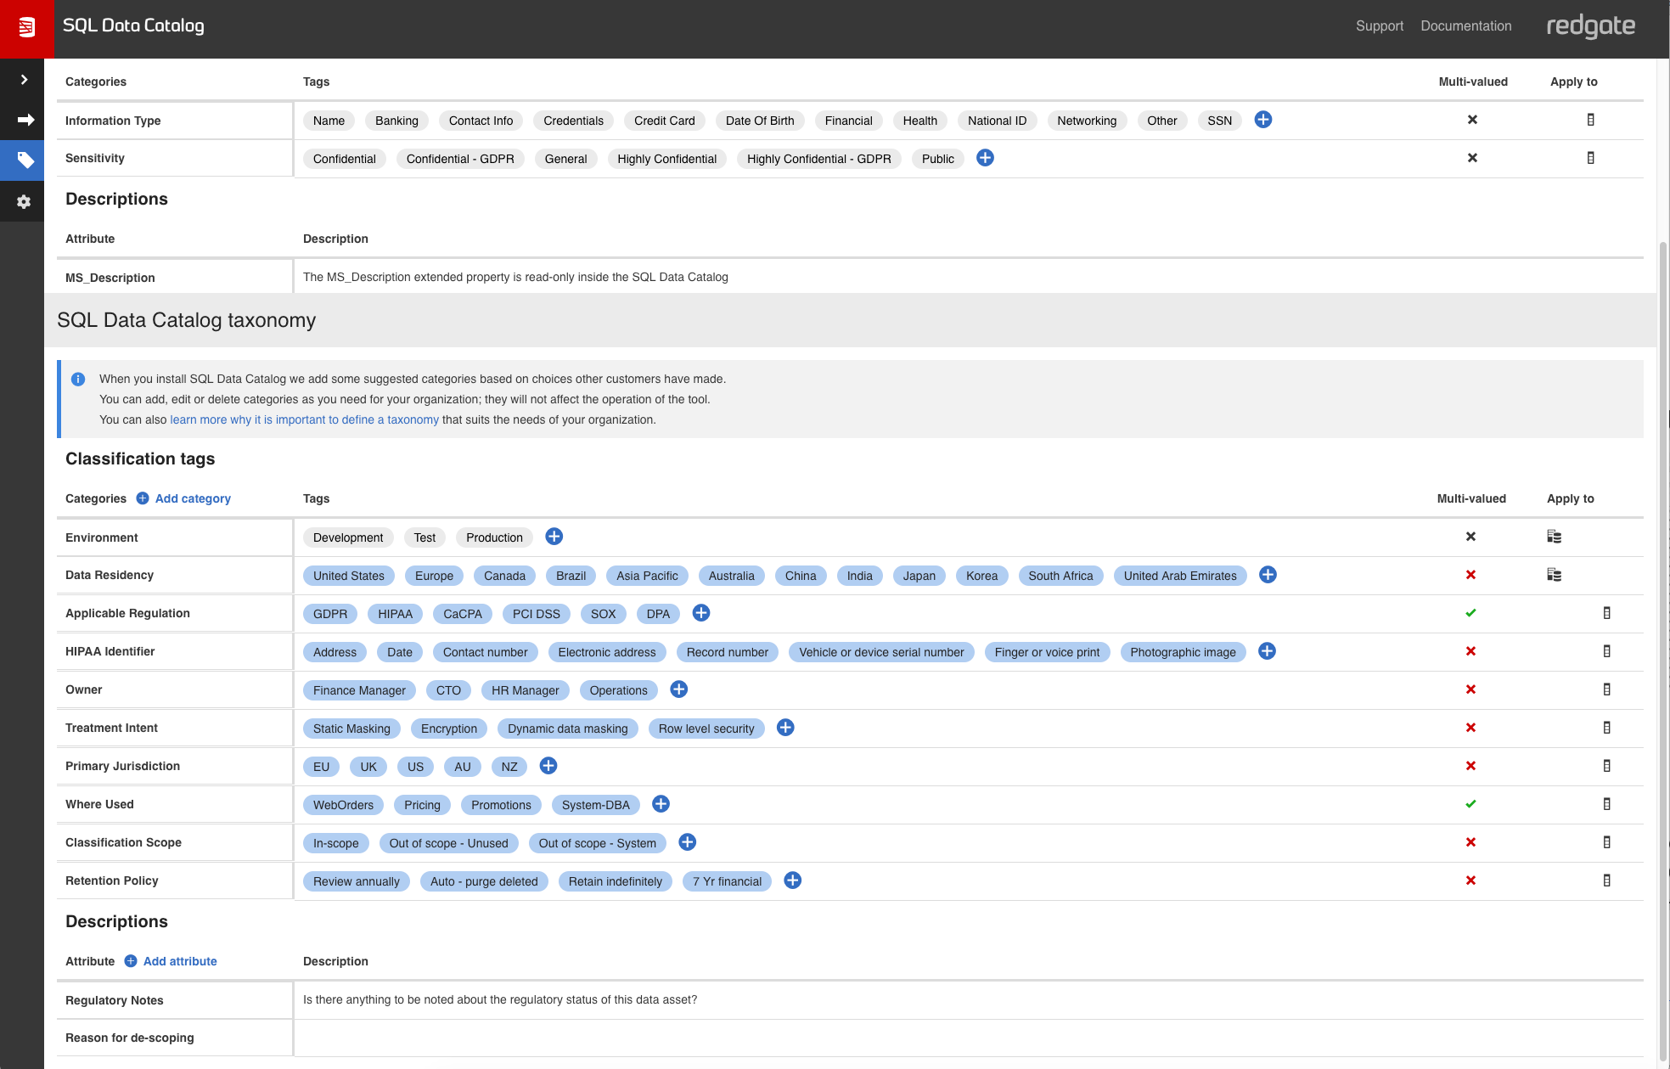
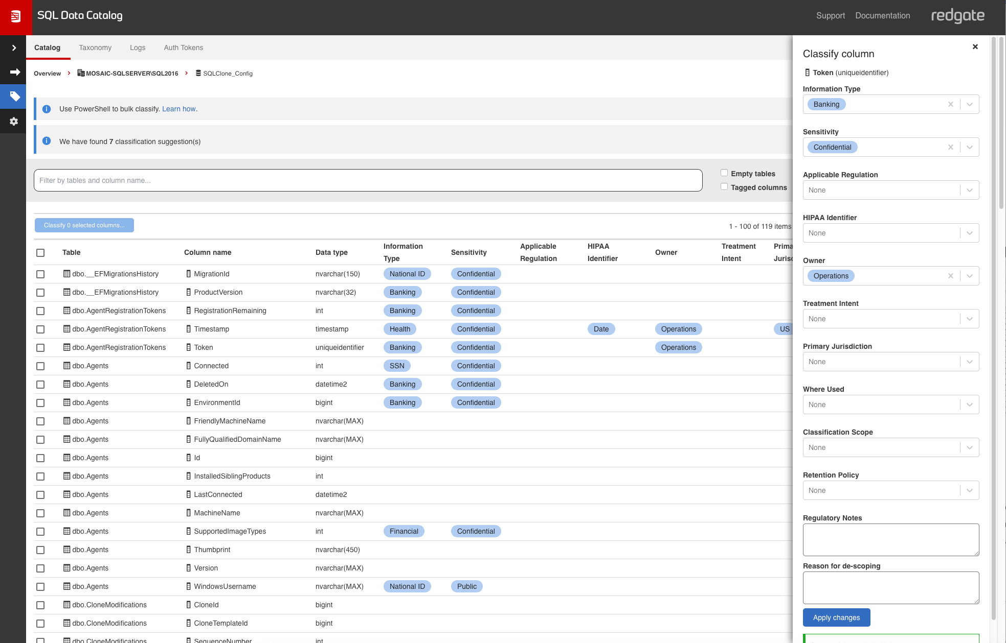
Create a business-wide accepted taxonomy

Slide 26
Align people
on data risks

Slide 27
Limit the damage
by knowing the impact

Slide 28
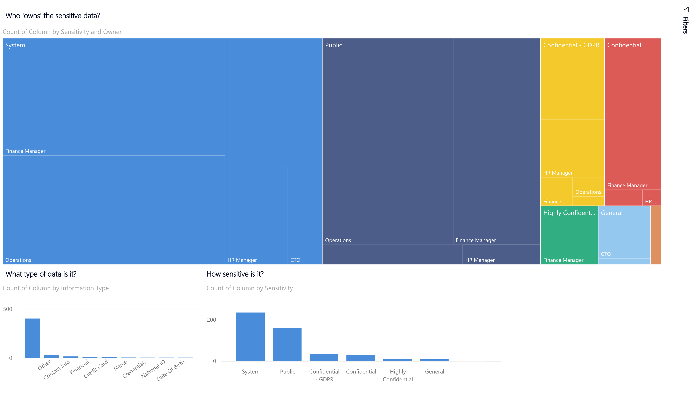

Slide 29
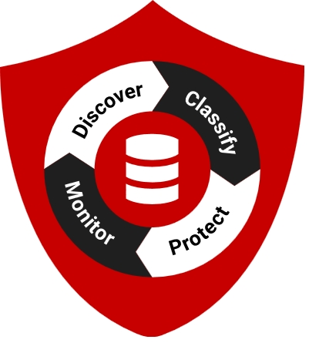
Approach data protection correctly
Where is your data?
What exactly is your data?
Who is accessing your data, and for what purpose?
How can you demonstrate adequate protection?

Slide 30

Questions?
Notes:
https://unsplash.com/photos/j6brni7fpvs

